Slide 1







Programming
Basics
By Ahmed Abubakr

Slide 2

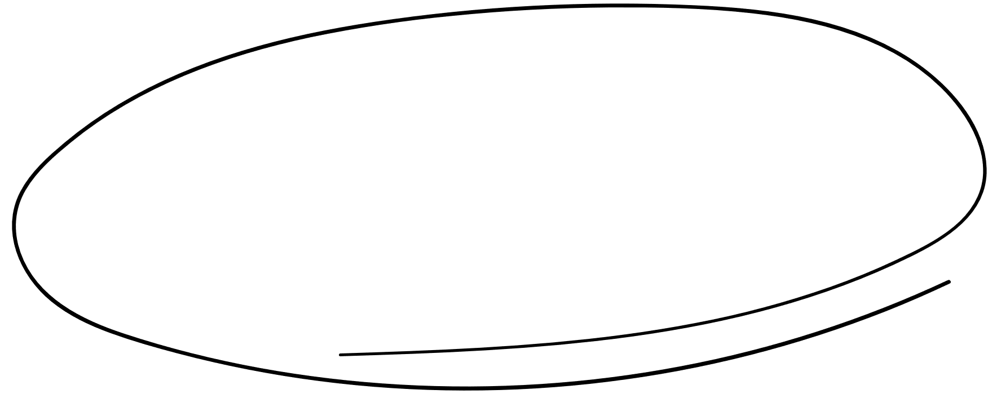

Contents
1
INTRODUCTION
2
WHAT IS PROGRAMMING
3
FIELDS OF PROGARAMMING
4
Operating systems
5
PROGRAMMING LANGUAGES
6
PROGRAMMING LEVELS
6
Extensions
7
High level programming

Slide 3



Introduction
Who Am I ?
Who Can Learn Programming ?
Why We Learn Programming ?

Slide 4





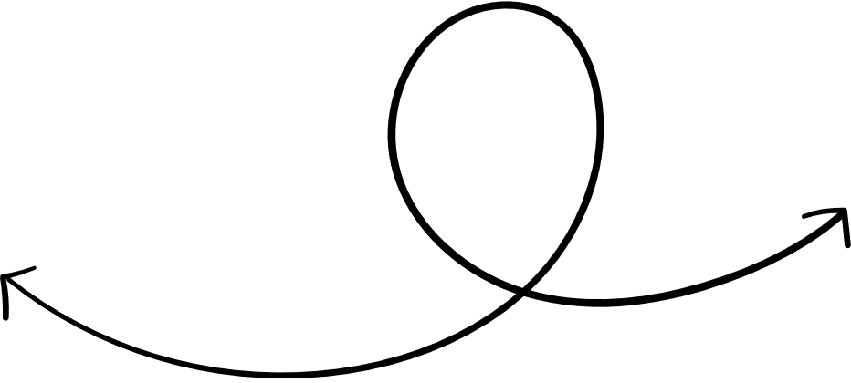


About me
Ahmed Mohamed Abu-Bakr
Electrical Engineer
Ahmed Abubakr

Slide 5
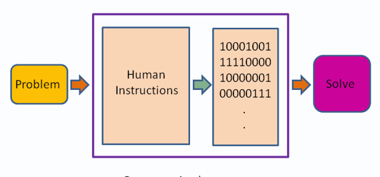
What is Programming
Writing a set of instructions that is executed by the machine to perform a specific task

Slide 6

How to select programming language ?

Slide 7



Web Development
Cyber security
Desktop applications
IOT
Fields of Programming
Android Applications
AI

Slide 8




What is operating systems ?

Slide 9
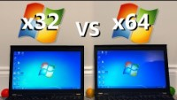

Do you know the Difference between windows 64Bit and 32Bit
Windows 32-bit vs 64-bit | Speed Test - YouTube

Slide 10
Do you know the Difference between windows 64Bit and 32Bit
A 32-bit system can access 2³² different memory addresses, i.e 4 GB of RAM or physical memory ideally, it can access more than 4 GB of RAM also. A 64-bit system can access 2⁶⁴ different memory addresses, i.e actually 18-Quintillion bytes of RAM. In short, any amount of memory greater than 4 GB can be easily handled by it.
Windows 32-bit vs 64-bit | Speed Test - YouTube

Slide 11

Lets see hackers interface
Open search on windows taskbar and type cmd then press enter

Slide 12
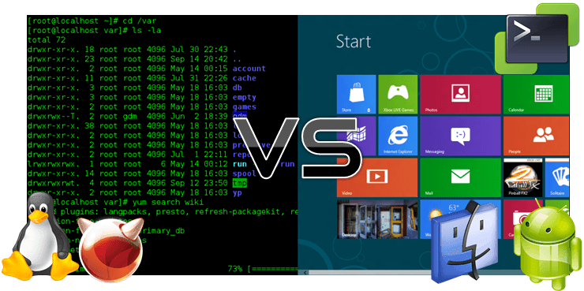
What is operating systems interfaces ?
Notes:
Get windows type (64bit – 32bit)

Slide 13
JavaScript
C++
Java
Programming Languages
C#
Perl
Python
PHP

Slide 14
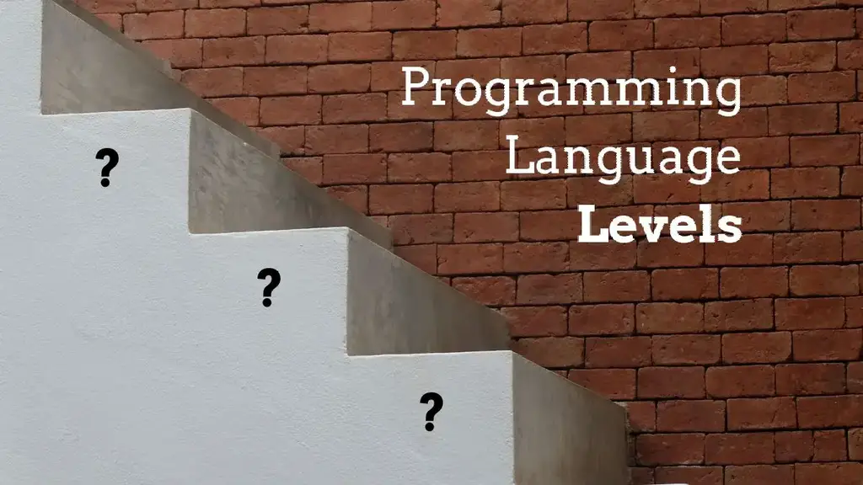

Slide 15




Programming levels
Low level
High level
Machine Code and Assembly Language.
Java, Python, PHP, Perl, C#, JavaScript, etc.

Slide 16
f
What is extensions ?
File.jpg
File name
extension
Dot to separate

Slide 17

Machine language | Low level (Assembly) | High level (C++)
100010110001010111111100111111111111111111111111101000011111100011111111111111111111111100000001110100001010001111110100111111111111111111111111
mov edx, DWORD PTR [rbp-4]
mov eax, DWORD PTR [rbp-8]
add eax, edx
mov DWORD PTR [rbp-12], eax
z = x + y;

Slide 18
But what is different between high level languages ?

Slide 19

In brief expression there is two main types of high level languages
Scripting languages (interpreted) sets of instructions that automate tasks that would otherwise be performed manually by a human.
Compiled languages need to be compiled before running and instruct the computer to perform tasks/calculations, including how to perform them (although if you're using a high-level language the low level instructions are hidden in the syntax).

Slide 20
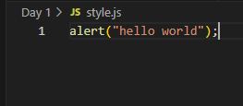
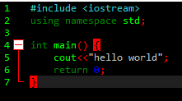
Lets see two codes in compiled and interpreted languages

Slide 21
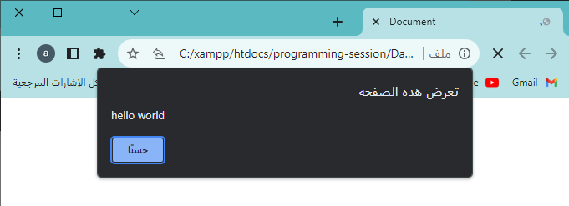
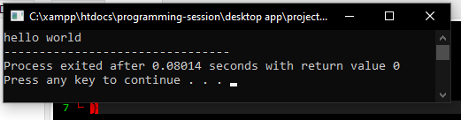
And know lets see the output

Slide 22
Things you should know about any programming language at start
Array
function
Structure of program
Syntax
Variables / Constants & datatypes
Conditional Statements
Loops
Arrays
Functions
Derived
Int
Float
bool
Char
String
Built in
Numbers

Slide 23
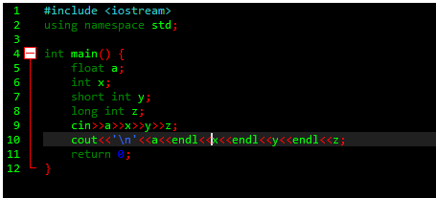
Type this code and till me what did you figure out

Slide 24
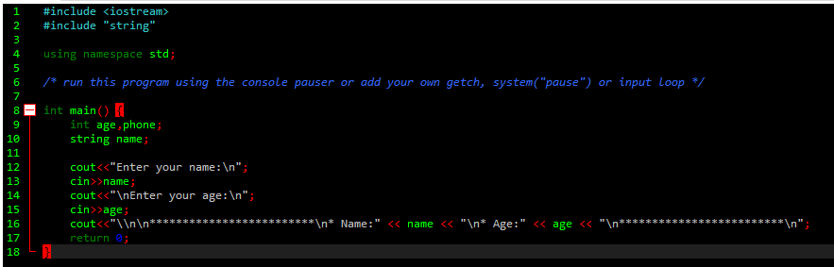

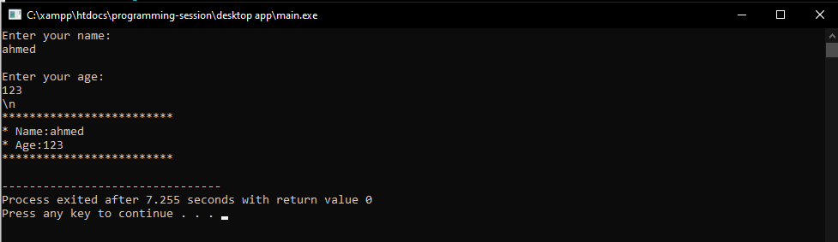
Example on (CPP)

Slide 25


Task 1 on CPP
Create a triangle with stars (*) for 7 layers with two ways

Slide 26
Task 2 on CPP
Create program that takes character and number and prints a number of pyramids with this number and each consists of the same character you entered

Slide 27
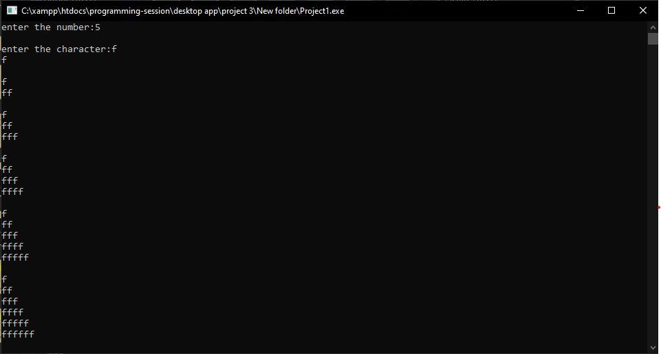

Slide 28
Task 3 on CPP
Create program that takes 5 numbers and prints:-
1-the biggest number
2-the least number
3- averages all of them

Slide 29
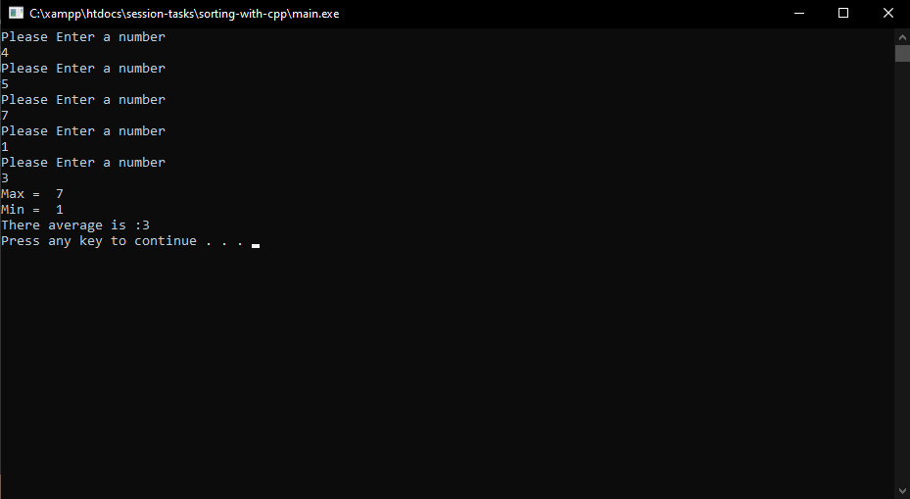

Slide 30


The End
in the end I hope you understood all I said contact on :

